Slide 1


Workflow News
Introduction

Slide 2


Workflow News
Startup created to demonstrate some of the uses of World of Workflows
Everything being done is open source and you can follow along
If you can use GitHub, you can even contribute and can become a founder.
Lets get it introduced

Slide 3

What is Workflow News?
Workflow News is an app and a business that:
Gathers your preferences
Gathers News from multiple sources
Provides it to you as a daily newsletter
It will be run like a proper startup but:
Everything will be public domain
You can get involved

Slide 4

The Why
Everyone lives in their own echo chambers for news
News aggregators are either for large business or require you to “get” the news
We’ll be different because:
You’ll get your very own newspaper in your inbox every day
You can say what you like or don’t like and we’ll change it
AI will summarize your day into lots of TL;DR bits

Slide 5

The How
Get a domain
Get a Logo
Write a business plan
Write an MVP
Release

Slide 6
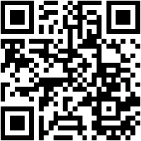

How you can help
https://github.com/World-of-Workflows/Workflow-News
Raise Issues
Create Pull Requests

Slide 7

See you online

